Slide 1
Introduction to Social Media for Small Business

Slide 2
Welcome
Housekeeping
Agenda

Slide 3
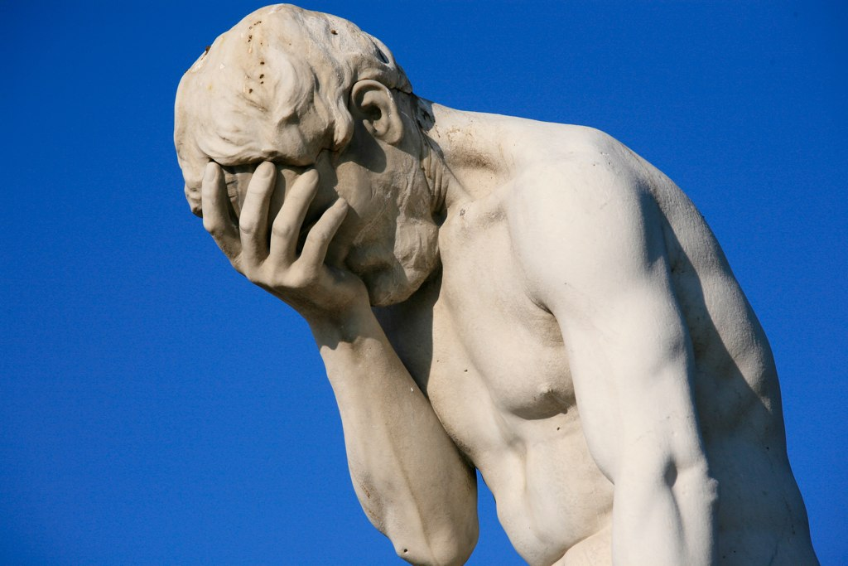
Is this familiar?
Is this what you do every time you think of doing Social Media for or in your business?

Slide 4
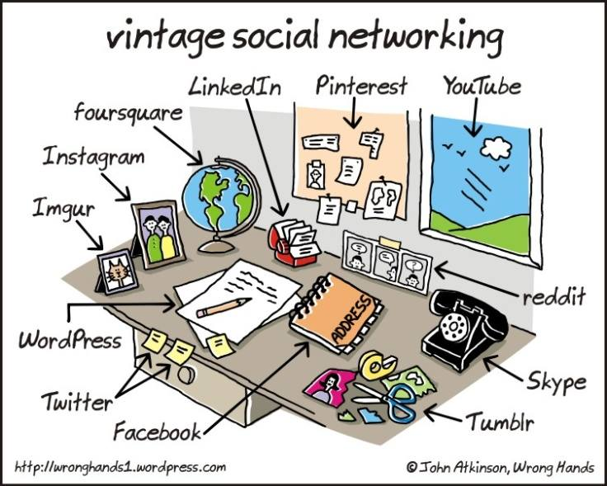

Slide 6
What is Social Media?

Slide 7
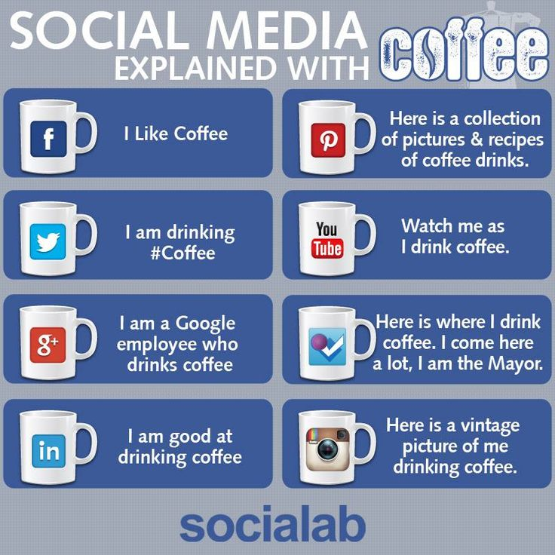

Slide 8
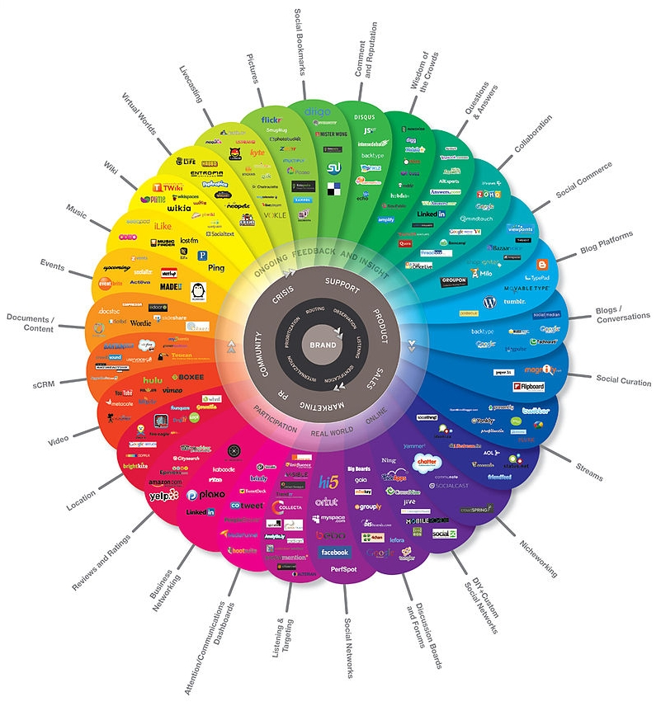

Slide 9
What type of Social Media User are you?
The bystander A listener
A social butterfly
The utilitarian A troll
The influencer A passionista
An early adopter
The evangelist
A complainer

Slide 11
Shh!!

Slide 12
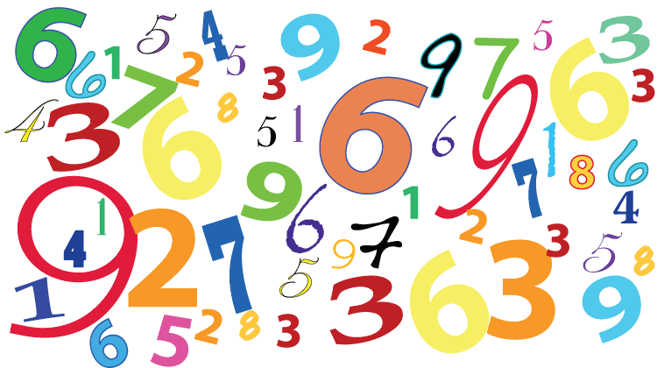

Slide 13
B2B B2C C2C B2G

Slide 15
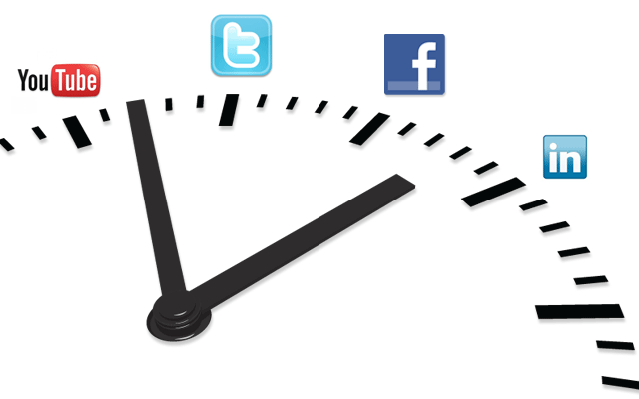
Timing is everything

Slide 16
Visuals

Slide 17
#Hashtags

Slide 19
Do’s
Don’t'

Slide 20
For each answer score
① NO ② NOT SURE ③ MAYBE ④ PROBABLY ⑤ YES
QUESTION | Score
Is my target audience here
Are my competition engaging here
Can I see marketing opportunities here
Could I get started here quickly
Could I use paid advertising to target specific groups
Could I enjoy engaging here
TOTAL

